Slide 1
Kyle Ashburn
CIS 2268
Database Project

Slide 2
Introduction
My data base is based on the premise of a database that tracks salaries and job information. I made a few assumptions that should be clear from my design.
I assumed that the list of things the database should have was not a list where every box had to be checked but more of a guideline for approaching the project.. As such I didn’t put in a correlated subquery, I didn’t put in a composite key, I didn’t use an in operator and a couple of minor things.
I created a new user so I hope your system password is system.☺

Slide 3
Database Structure
My DDL is below.
city_zip (zip, city, region_id(FK))
jobs (job_id, category_id(FK), description, job_name)
category (catergory_id, category_name, description, field)
salary (salary_id, job_id(FK), category_id(FK), zip(FK), salary)
region (region_id, region_name)

Slide 4
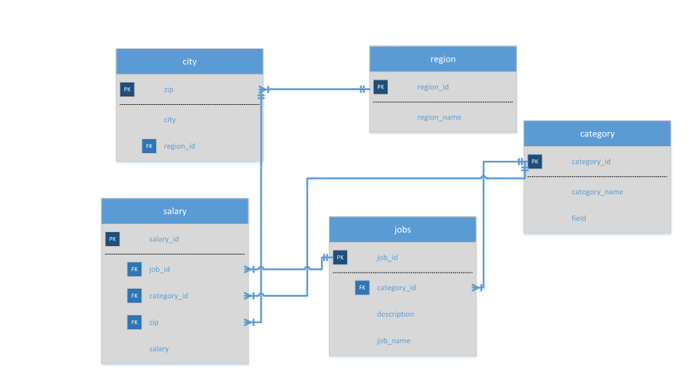
Database Structure(cont.)

Slide 5
Query #1
SELECT j.job_id, j.job_name, c.category_name, salary, cz.zip, city || ', ' || state AS location
FROM jobs j
INNER JOIN category c
ON j.category_id = c.category_id
INNER JOIN salary s
ON s.jobid = j.job_id
INNER JOIN cityzip cz
ON s.zip = cz.zip
INNER JOIN region r
ON r.region_id = cz.region_id
WHERE state = 'NC' OR state = 'OH'
ORDER BY state DESC, city ASC, category_name ASC;

Slide 6
Query #2/3
--Query 2
SELECT state, SUM(salary) AS state_sal_sum
FROM region r
INNER JOIN cityzip cz
ON cz.region_id = r.region_id
INNER JOIN salary s
ON s.zip = cz.zip
GROUP BY state
ORDER BY SUM(salary);
--Query 3
SELECT DISTINCT region_id, state
FROM region;

Slide 7
Query #4
--Query 4
SELECT jobid, job_name, salary, zip
FROM salary s
INNER JOIN jobs j
ON j.job_id=s.jobid
WHERE salary >
(SELECT AVG(salary)
FROM salary )
ORDER BY salary;

Slide 8
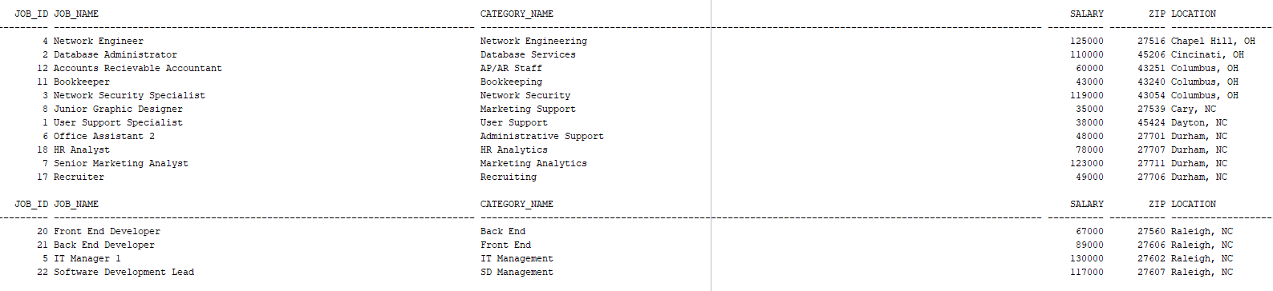
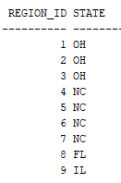
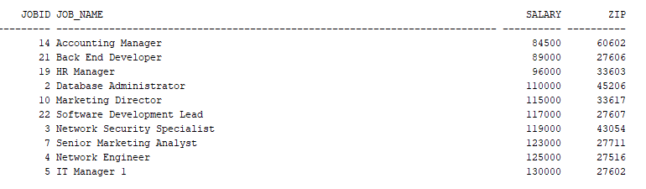
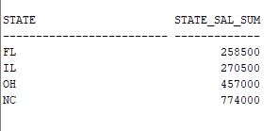
Query Results(1-4)

Slide 9

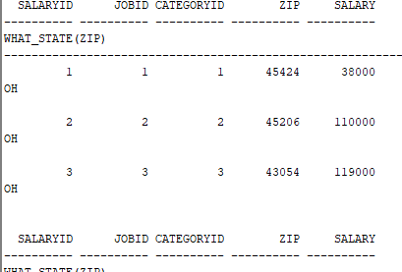
Query #5/Function Demonstration
--Query 5
SELECT MAX(salary)-MIN(salary) AS salary_range
FROM salary;
-- Using Function
select salaryid, jobid, categoryid, zip, salary, what_state(zip)
FROM salary;

Slide 10

Trigger Demonstration
--Using Trigger
INSERT INTO region
(region_id, region_name, state)
VALUES
(region_id_seq.nextval, 'New York City', 'ny’);
--Select Statement Proof
SELECT state
FROM region r
WHERE region_name LIKE '%New York%';

Slide 11
Procedure Demonstration
--Demonstrating use of procedure
CALL insert_row_category_proc
( 'Ninja-Clown(Mime)', 'Espionage/Entertainment');
--Results
SELECT *
FROM category
WHERE category_name LIKE '%Ninja%';

Slide 12
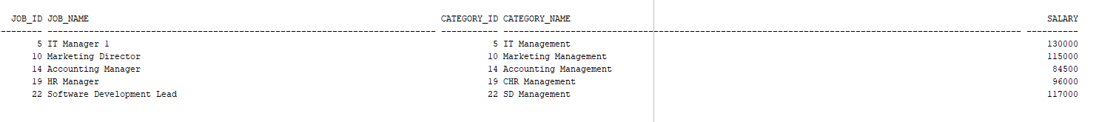
View Demonstration
SELECT *
FROM managers;

Slide 13
What would I do differently?
I tried to use access to build it but apparently you can’t import a database anymore so that wasted time; I wouldn’t try that if I was doing this again.
I would improve my queries; some felt really weak. In particular I would include a correlated subquery.
I would probably add a composite key just for kicks.
I would add more data.
Make a better powerpoint! ☺

